Slide 1




SQL Security Principals 101 Database Professionals Virtual Meetup Group Feb 2021

Slide 2
Agenda
Security Principles
SQL Authentication and Logins
Role Based Access Control
Azure SQL DB Differences
Database Object Security
Demo
Notes:
Today we’re going to cover a lot of important foundational material about security, accounts, authentication. For folks new to Microsoft SQL Server security design and administration, this will be a great foundation.
But I think there is content in here to interest everyone at different levels of experience with SQL Server.
I’m focusing my content on what we in DevRel could take away when we’re building demos and tutorials, so we can demonstrate exemplary security. We don’t want our own walkthroughs scripting out shortcuts in security that end up in customer’s production systems.
Let’s get started!

Slide 3
Section Title 3
Authentication and Logins

Slide 4
Principal vs Principle
Principal
(noun) a person who is in charge of some responsibility
Example: The principal consultant talked to the school’s principal.
(adj) original, most important
Example: The principal aim of a good DBA is to defeat wicked developers.
Principle
(noun) a rule, guideline or fact
Example: Our guiding principles are based on science.
Notes:
So this is a common grammar issue in the English language, the difference between principal, P-A-L and principle, P-L-E.
Both can be a noun, but PAL describes a person, a person who could be your “pal”. A principle PLE is an inanimate thing, like guiding principles, or being principled.
So today, we’re really talking about both. Principals, PAL, are also what we call security objects in a database server. Principles, PLE, guide us.

Slide 5
A Principal’s Principles
We can all be Principled Principals
who follow Principal Principles of security.
Notes:
My title at my last job was Principal Consultant, so this past Principal is going to share with you his Security Principles.
And for this audience, I’m talking about the principles we principals demonstrate in our sample and walkthroughs.
<read slide>

Slide 6
Why is Security Important?
Proper implementation of SQL security principals:
Decreases administrative effort
Decreases application complexity
Decreases database surface area

Slide 7
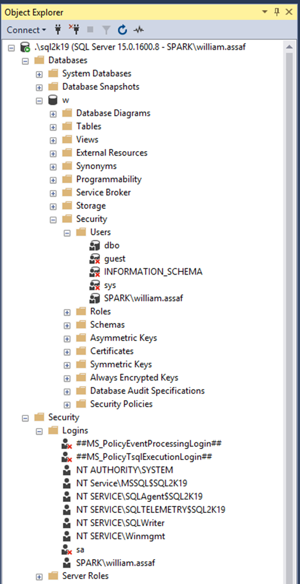
Login vs User
Database User
Server Login
Has a database context
Often linked to a Login*
Does not have a password*
Stored in a Database
Included in DB Restore
*Most of the time. We’ll talk about it.
Connects to a SQL Instance
Linked to AD (Windows Auth) or have a password (SQL Auth)
Stored in the Master system database, so is not included in other DB restores
Notes:
<read slide>
So over here in a screenshot from Object Explorer in SQL Server Management Studio, the Security folder under database has a subfolder for Users. The Security folder under server has a subfolder for Logins, and I’ve circled a login and a user here that have the same name.
So key takeaway here is that in SQL Server, logins handle authentication. Authentication can be through Active Directory, or as an alternative, internally via SQL Server authentication.
SQL Server authentication sounds simpler, contained, but we’ll talk about how that’s actually not advantageous for managing security.
Now, what have I already done wrong here?
I should create logins for to AD Security Groups, not individuals, not accounts with my name on it.

Slide 8
AD Security Groups
Create logins for to AD Security Groups, not individuals. Insist on it.
Be aware of who is a member of those groups, and what groups are a member of groups, and what groups are a member of those groups…
Notes:
Insist on it in tutorials, examples, walkthroughs.
Devs -> App Support -> QA -> Financial Analysts…

Slide 9
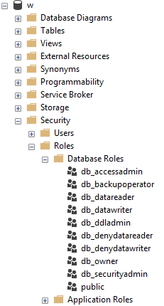
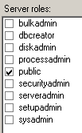
Server and Database Built-in Roles
Roles are security principals too.
Logins added to Server Roles.
Users added to Database Roles.
Built-in Roles to provide a standard for access that may be too broad.
Notes:
<read slide first, until too broad> When granting permissions to a database user, assign specific permissions when possible. While you can add a user to the built-in database roles, like db_datareader or db_datawriter, that might be overreach.
Your data within a database may not be homogenous in terms of sensitivity/permissions to access. Even a reporting login may not need access to everything in the database.

Slide 10

Public Roles
Every login/user is a member of “public”.
All logins/users inherit permissions granted to public.
Never grant permissions to a public role.
This is a red flag on any security audit.
STIG SV-53924r1_rule.
Toolbox: 1 - public permissions.sql
Notes:
<read notes instead>
On the sample image here, you’ll notice the server role public checkbox is always checked. And it can’t be unchecked.
Let’s talk briefly about the public roles.
Every login is a member of the public server role. Every user in each database is a member of that database’s public database role.
Only short-sighted developers would grant permissions to public, which allows every user - that does or ever will exist - to inherit permissions from public.
Permissions granted to a public role are a red flag, so never recommend it in any tutorials, walkthroughs, etc. In fact, there’s a STIG prohibiting this, if you’re into STIGS, these are audit findings the government and military use for security audits.
Source: https://www.stigviewer.com/stig/microsoft_sql_server_2012_database/2013-11-10/finding/V-41398

Slide 11
Guest
Special built-in user in each database.
Any login that doesn’t have a mapped user in a database inherits GUEST.
By default, this is disabled in all databases.
Check for this.
Toolbox: 2 - guest permissions.sql
Notes:
<read slide first>
For what should be very obvious reasons, never grant any permissions, even CONNECT, to GUEST, unless you understand what you’re doing.
If a login doesn’t have a user in a database, it shouldn’t have access to the database.
Not a secure solution for future access. Similarly, this could also trip a SQL Server security audit failure.

Slide 12
Server Logins + Database Users
A Server Login is what authenticates a connection to SQL.
A Database User provides a Login with database access.
Notes:
<read notes instead>
So, just a vocabulary reminder here.
“Login” is a server level security principal.
“User” is a database level security principal.
Now, let’s talk about the different types of Logins. They’re differentiated by how they authenticated to SQL Server.

Slide 13

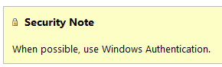
Windows Auth > SQL Auth
SQL Logins are authenticated by a SQL Server instance. Windows Auth Logins are authenticated against AD.
SQL Auth: “Enforce Password Policy” not required!
Toolbox – 3 easy passwords.sql
Notes:
<read notes instead>
<click>
1. Now using SQL Authentication means each SQL Server is now an authority for its own credentials. If you have 10 SQL Server instances, that 10 different sets of logins and passwords to maintain, as opposed to one Active Directory.
<click>
2. You are strongly encouraged to Enforce password policy for SQL Authenticated Logins, which can include password expiration and complexity, inheriting from policy.
Unfortunately, in SQL Authenticated Logins, this is optional! Password could be password, empty string, or the same as the user name.
<click>
3. Multiple failed SQL Authenticated login attempts will cause a Login to become Locked Out, which a DBA must resolve.
Again, and this is straight out of Docs and has been there since day one: when possible, use Windows Auth.

Slide 14
Windows Auth and Apps
Using Windows Auth requires the OS to authenticate.
In Windows, this is the SSPI, which will authenticate via Kerberos or NTLM. This is non-trivial.
Kerberos requires Service Principal Name (SPN).
NTLM = old MS Authentication protocol that Kerberos replaced.
If you get SSPI issues, it’s likely a double-hop or trust issue.
Use Service Accounts in all cases, SQL or Windows Auth.
Notes:
Now, to be fair, Windows Authentication does have a complexity increase.
<click>
<read slide bullet points 1-5>
<read notes>
You may have encountered this before if trying to use Windows Authentication from an Internet-facing server, like an App Server in a DMZ, or otherwise outside of the domain. Kerberos may be required to authenticate a Windows User directly from the application server to the SQL Server. Can increase the complexity of an application loadout, but this is the Enterprise approach. I don’t have time to do a deep dive on this today, but this is fairly well documented and may involve your Active Directory admins helping to configure.
<click>
This is why I still see SQL Authentication used by many applications, because developers don’t want to have to ship applications that depend on this kind of trust. To be clear, this is less secure.
The best way to design this is that applications that SQL Logins at least use a SQL Login that isn’t used interactively.
When I say interactively, I meant that no human is ever typing in this user name and password. Make the password painfully long, even.
Make sure that developers themselves don’t use the SQL Login, they should still use their own Windows Authentication, even if they are external vendors. A defining characteristic of a Service Account is that nobody knows its password, and at least, it isn’t used interactively.
We’ll talk about service accounts more later on, and especially the different options around Windows Authenticated Service Accounts.

Slide 15
Windows Auth > SQL Auth
SQL Auth: More effort to maintain, migrate, secure.
Windows Auth: Easier to practice RBAC
Notes:
<read notes instead>
But overall, Windows Authentication does make our job as DBAs earlier.
Centralizing account and password management, role assignment, these are good things to do from a governance standpoint and from the standpoint of…. that thing you see on Certification Exams? “Least amount of administrative effort?”
RBAC or Role Based Access Control is an acronym many in the governance area are familiar with, the idea that nobody gets permissions that are unique to them, they are only granted permissions based on their role, not their individual needs.
Role Based Access Control means that creating specific permissions is a meaningful exercise, because it’ll be applied to members of a group.

Slide 16
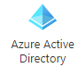
Role Based Access Control (RBAC)
Windows, AD, or preferably Azure AD makes this easier to accomplish.
Security groups already exist in Active Directory, let’s leverage them.
Most of this talk applies to all Azure SQL platforms.
Notes:
<read notes instead>
So Role-based access control is best when leveraging Active Directory, using security groups.
SQL Server Authentication can also be role based, but it exists within each SQL instance and is not a centrally managed security system, so it is not a scalable solution.
<click>
Security groups already exist in active directory, let’s leverage them. Let’s leverage AD or Azure AD to centrally manage the identities of database users in one central location.
<click>
A lot of what we’re talking about throughout this presentation applies to SQL Server, again whether it’s in a SQL Server instance on a VM in Windows or Linux or in Managed Instances, in all S.L.O.’s of Azure SQL DB, or in the SQL Server based nodes and pools of Big Data Clusters, Dedicated SQL pools, and Synapse.
Exceptions to this rule include Big Data Clusters, where SQL Authentication is the only option for SQL to SQL authentication inside the Cluster, and Azure SQL Edge, currently only supports the built-in SQL Authentication mechanism.
Note here I am not talking about Azure users and permissions used to secure Azure resources in the Portal or otherwise. Azure permissions are completely different than permissions inside a database, for good reason. Azure architects probably don’t need direct database access.
https://docs.microsoft.com/en-us/sql/big-data-cluster/concept-security?view=sql-server-ver15#encryption-in-flight-and-other-security-mechanisms

Slide 17

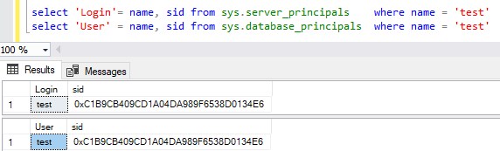

Logins + Users
A User can be linked to any Server Login
The names don’t actually have to match, but they should.
A SID (Security-IDentifier) is shared by User and Login.
Notes:
<Read notes instead>
Let’s talk a bit more about Logins and Users. I mentioned Users give Database Context to a Login. But how are they actually related?
<click>
Logins and Users are matched by a Security Identifier, or SID. The names don’t actually have to match, but they should.
Here you can see I’ve got a login and user with the same name but most importantly, with the same SID.
However, users can become orphaned from their logins if the SID’s don’t match. This most commonly occurs when restoring a database from one server to another, the user moves, but the login doesn’t.

Slide 18
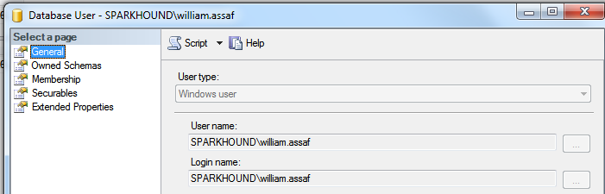
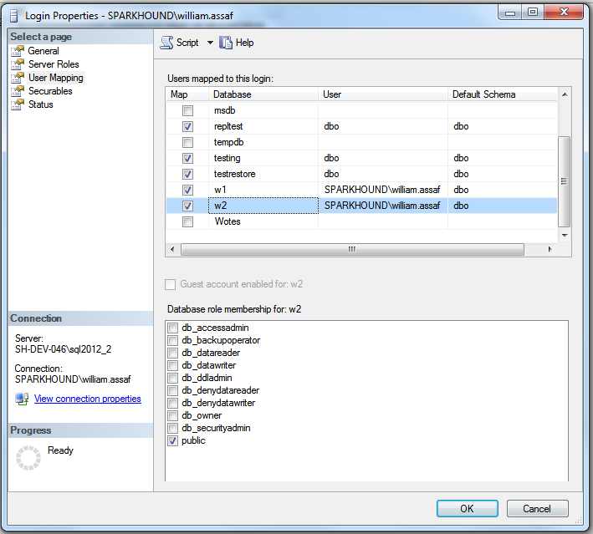
Login Mapping to Database User
Logins are mapped to Users in the User Mapping page of the Login properties dialog.
Notes:
It’s here in the mapping that users take on the SID of the login.
Note here also the user “dbo”, this is a special user in each database that sysadmins can use. We’ll talk more about dbo and its shifting uses over the years later on.

Slide 19
Fix Orphaned SID
Only happens to SQL Authenticated logins.
To re-associate a database user to a server login:
ALTER USER username WITH LOGIN = loginname;
SELECT DBUser_Name = dp.name
, Login_Name = sp.name
FROM sys.database_principals AS dp
INNER JOIN sys.server_principals AS sp
ON dp.name = sp.name
WHERE sp.sid <> dp.sid;
Notes:
<read notes instead>
Now this only happens to SQL Authenticated Logins, one of the many drawbacks of SQL Authenticated Logins. That’s because SQL Auth Logins can get a different SID on each SQL instance. Now, don’t gloss over this detail. Unless you specify a SID yourself when creating a SQL Auth Login, the SID for a SQL Server Login is generated locally at each SQL instance. If you create a Login named test on 5 different SQL server instances, you’ll get a Login named Test with five different SIDs. So when you’re doing migrations or setting up multiple replicas, and you have to do this through TSQL not the UI, create a SQL Auth Login with a pre-determined SID.
This doesn’t happen to Windows Authentication accounts because that SID comes from Active Directory. So as long as they’re in the same domain, all SQL instances get the SIDs for Windows Authenticated logins from the same place, AD. That way, in all SQL Servers, the AD logins have the same SID, so a user in a database can’t become orphaned if it’s moved to a new instance.
<click>
To fix an orphaned SID and reunite the Login with its User, the command is actually quite simple.
<click>
And you can also proactively identify orphaned logins by comparing their names and SID in SQL Server’s internal metadata.
For DBAs, a good habit to form is remembering to look for and fix orphaned SIDs is a necessary followup any time a database is restored from one server to another, for example, when you update a dev or test environment from production.

Slide 20
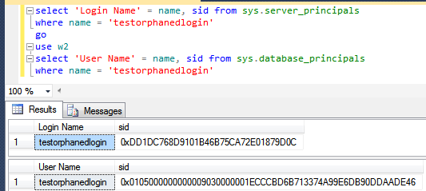
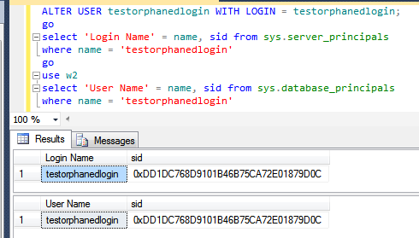
Fix Orphaned SID
Notes:
You’ll know you have a problem with an orphaned SID if the end user or application gets an error like this. “The server principal is not able to access the database under the current security context“, this is a symptom of a mismatched SID. IF Login and User both exist, with the same names, but its not working, it’s almost certaint he SID.
<click>
And here, we can verify in the system views that indeed, I’ve got a SQL authenticated login and a Database User of the same name, but different SIDs. If you’re not familiar with this TSQL syntax, that’s ok, it’s pretty self-explanatory, we’re looking at server_principals and database_principals.
<click>
After running ALTER USER with LOGIN, you can see now that the Database User has been modified to reflect the SID of the login on this SQL instance.

Slide 21
SQL Auth Login Migration
Not possible to reverse-engineer a SQL Auth Login password.
Migration of SQL Logins is accomplished by:
Backup+restore of the master database (complicated) -OR-
Creating SQL Logins with same SID but new password (not desirable) -OR-
Generating a hash of the password and same SID (most desirable) Let’s go more into that….
Notes:
<read notes>Like we said earlier it is not possible to reverse-engineer a SQL Auth Login’s password, you can guess it an infinite number of times via the hashing algorithm we discussed earlier, but you can’t see it.
So when migrating SQL Logins from one instance to another during an upgrade or migration, you have options.
<click>
The first option involves restoring the master database, which is obviously only possible in a migration to the exact same SQL Server version. You may also find this more or less impossible if the drive letters are changing, so consider restoring the master database an important disaster recovery option in the event of a baremetal restore, but not an option for server upgrades.
<click>
Scripting out all SQL Logins with the same SID but a new password is possible, but breaks a lot of connection strings, and it’s unnecessary because,
<click>
The best options is to do what we mentioned earlier - we can retrieve the SQL-generated SID of the login from the old server, generate that hash of the password, all without knowing the password, then recreate a login on the other instance. This is easily scriptable. Let’s talk more about that.

Slide 22
SQL Auth Login Migration
Microsoft has provided a pair of sprocs to generate the hash of passwords: support.microsoft.com/kb/918992
sp_hexadecimal + sp_help_revlogin
But don’t forget to migrate the server-level permissions:
Toolbox: security Script servers.sql

Slide 23
SQL Auth Login Migration
Microsoft has provided a pair of sprocs to generate the hash of passwords: support.microsoft.com/kb/918992
sp_hexadecimal + sp_help_revlogin
Create both in master then EXEC sp_help_revlogin
But don’t forget to migrate the server-level permissions:
Toolbox: security Script servers.sql

Slide 24
SQL Auth Login Migration
Microsoft has provided a pair of sprocs to generate the hash of passwords: support.microsoft.com/kb/918992
sp_hexadecimal + sp_help_revlogin
Create both in master then EXEC sp_help_revlogin
Notes:
This will script out all logins for you in fact, but you can find in the output the SQL logins you want.

Slide 25
SQL Auth Login Migration
Migrating a SQL Login with its password and SID is critical.
Regular proactive check for all replicas in availability groups:
Check that all Logins exist AND All SQL Logins have same SID
Notes:
<read slide first>
This is also important for setting up new Availability Groups, as the Login SIDs must match on every replica. Otherwise, after failover, the master database on the new primary replica, which isn’t replication, won’t match the SID on user database, which is replicated.

Slide 26
SQL Auth Login Migration
But don’t forget to migrate the server-level permissions:
Toolbox: 5 - security Script servers.sql
Notes:
And of course if you’re also doing a migration by backing up and restoring user databases from one server to another, the database level permissions come across with the database, but server level permissions are stored in the master database, like we talked about earlier.
And just a reminder, at this point if you have any questions, please use the Audience Response System to ask and I’ll do my best to answer.

Slide 27
Login vs User
Database User
Server Login
Has a database context
Often linked to a Login*
Does not have a password*
Stored in a Database
Included in DB Restore
*Most of the time. We’ll talk about it.
Connects to a SQL Instance
Linked to AD (Windows Auth) or have a password (SQL Auth)
Stored in the Master database, so is not included in other DB restores
Notes:
So back to this. Again, we’ve been talking about the difference between Logins and Users and how the SID, not the name connects them. Now, don’t forget everything I just told you, but… well, there’s this thing called contained databases.

Slide 28
Contained Databases
Moves authentication from the Server level directly to the Database level.
A contained database owner, for example, has full control over authentication to the database.
No server-level (or sysadmin) permissions necessary
Notes:
<read notes>
So again, we’ve been talking about the difference between Logins and Users and how the SID, not the name connects them. Now, don’t forget everything I just told you, but… well, there’s this thing called contained databases.
<click>
A Contained database moves authentication from the Server level directly to the Database level.
<click>
A contained database owner, for example, has full control over authentication to the database, with no server-level permissions necessary to manage it.
Contained databases have no configuration dependencies on the instance, it can be easily moved to another instance.

Slide 29
Users With Passwords
What a Contained Database means is that this syntax, which until now made no sense, is perfectly valid:
USE [Contoso_DB];
CREATE USER [BI_User] WITH PASSWORD ='strongpassword’;
--or
CREATE USER [Contoso\BI_User] FROM EXTERNAL PROVIDER;
Notes:
<read slide first, then notes>
So, this is that asterisk on my early slide, talking about how only logins have passwords, well, most of the time.
A contained database user is a database user… with a password.
or, contained database user can be directly tied to an AD Account.
Here in contained databases, the user is the method of authentication to the database, not the login.

Slide 30
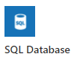

Contained Databases Sound Familiar
A platform where all the necessities for authentication and system objects are stored in the user database…
No system databases needed, so the database is easily portable between SQL instances…
What does this sound like?
Azure SQL Database!
Notes:
<read slide first>
This is the whole purpose of a contained database – unlimited portability on the back end, where Azure can move the database from instance to instance without having any ties to the instance, everything is contained inside the database, including authentication. You don’t know or care what instance your Azure SQL DB lives on, it’s completely contained and portable.
We also brought the contained database feature to SQL Server, where it’s actually labeled “partially contained” because of some minor details.
Let’s briefly talk about how the authentication and security principals here are different in Azure SQL Database from SQL Server.

Slide 31
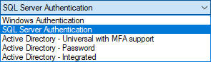
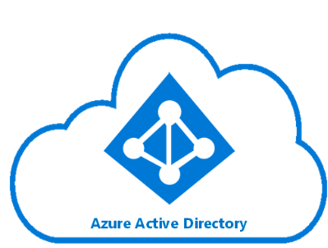
Azure SQL DB Authentication
Additional types of authentication since SSMS 2016
Image: https://docs.microsoft.com/en-us/azure/active-directory/hybrid/media/tutorial-federation/diagram.png
Notes:
The “Active Directory” dash options used for Azure AD only as Azure-based replacements for the Windows Authentication option.
You can of course use SQL Auth for an Azure SQL Database, and that’s really your first and only option for environment once it is created, before you have integrated Azure AD.
For all the same reasons as Windows Authentication for SQL Server, using the Azure AD authentication in Azure SQL DB is superior.

Slide 32
Azure SQL Admin Logins
Azure SQL DB Servers are logical servers only.
Azure SQL Logins in the master system database can be shared across databases.
You initially create one administrator SQL Auth login per Azure SQL logical server.
Notes:
<read notes instead>
Azure SQL DB <airquote> “servers” are logical servers only. And I say logical server because in the Azure SQL Database product, all the databases are contained. Unlike the master system database in SQL Server, the “master” system database in Azure SQL DB here can only store certain objects and is mostly read-only.
<click>
Just like in SQL Server, Azure SQL Logins can be created and linked to a SQL Authenticated user in a user database, if you have multiple databases in the logical server.
<click>
Initially, the admin account that you specify upon creating an Azure SQL DB exists as a SQL authenticated user, with administrative rights to all databases on the server.
That’s the only full admin login on the logical server that uses SQL Authentication, and you can’t create another.

Slide 33
Azure SQL DB + Azure AD
You can create one Azure AD administrator account with full admin permissions as well, via the Portal.
Only Active Directory accounts can create other Active Directory accounts in Azure SQL Database.
Notes:
<read notes instead>
You can create a second full administrator using Azure Active Directory, assigned via the Portal. Often, I see database folks adding their own Azure AD account as THE Azure Active Directory admin. Watch out for that antipattern, and again use Azure AD security groups for the role of the DBA or Database Developer as much as possible.
<click>
Once logged in as the Azure AD administrator, only then can you then add other Azure AD accounts as Azure SQL contained database users.

Slide 34
Common Security Platform
Otherwise, most permissions, objects, schema, and authentication operate the same on Azure SQL Database, Azure SQL Managed Instance (MI), Azure Synapse Analytics (formerly SQL Data Warehouse), SQL Server, and SQL Server on Linux.
Notes:
<read
In this presentation when we’re talking about permissions, stored procs, views, functions, it’s probably going to be the same for any platform. Azure SQL DB and Synapse are going to have some security specific differences, we’re not going to go into them in detail, but they’re well documented.
Now, speaking of the different platforms, let’s talk a bit about how we connect to them.

Slide 35
Connection Providers
OLEDB was un-deprecated, re-released in ‘18. https://blogs.msdn.microsoft.com/sqlnativeclient/2017/10/06/announcing-the-new-release-of-ole-db-driver-for-sql-server/
Install and Convert your OLEDB connection strings from sqlncli11 or sqloledb, to the new MSOLEDBSQL.
There is also a relatively new ODBC Driver 17 for SQL Server. https://techcommunity.microsoft.com/t5/SQL-Server/ODBC-Driver-17-for-SQL-Server-Released/ba-p/385825
Both replace the OLEDB/ODBC functionality of the SQL Native Client (SNAC) which is no longer maintained.
Important to update sqlncli10 for availability groups
https://www.sqltact.com/2019/06/actual-emails-will-msoledb-work-for.html
Notes:
<read notes>
A little bit on the current state of connection providers. You might have heard that OLEDB was dead, well, long live OLEDB, it’s now a first class provider again via the new MSOLEDBSQL provider.
<click>
There’s also a relatively new ODBC driver for SQL released by Microsoft.
<click>
Both replace the OLEDB/ODBC functionality of the SQL Native Client (SNAC) which is no longer maintained. I’m talking about SNACK 10 and SNACK 11 here, avoid using those for new development, and you’ll probably have no problem switching from either to the new MSOLEDBSQL provider.
<click>
Note that the SNAC10, which we released with SQL 2008, doesn’t have the parameters needed for successful connections to availability groups, and so that can be a hurdle to overcome for applications to start connecting to SQL Servers that have been migrated to availability groups.
Ok, this is a security presentation, enough about authentication, let’s talk permissions inside the server and inside the database.

Slide 36
Database Object Security
Permissions
Notes:
Now I’m going to talk a little bit about database object permissions inside the database. I’ll assume you know the basics of GRANTing permissions, some of the basic read and write access permissions inside SQL Server as well. If you don’t, that’s ok, they’re obviously named. I’ll also assume you’re familiar with the table, the basic storage object of any relational database, where rows are queryable by end users. It’s the relationship between that data in the table, and the user’s end queries that I want to explore with a simple exercise.

Slide 37
Basic User Permissions
DML*
DDL**
Modify Security
SELECT
DELETE
UPDATE
INSERT
REFERENCES
*Data Manipulation Language
ALTER
CONTROL
VIEW DEFINITION
CREATE
DROP
EXECUTE
**Data Definition Language
GRANT
REVOKE
DENY
IMPERSONATE
Notes:
Some basic permissions broken down here into three categories, some of these you’re probably already familiar with.

Slide 38
Common Permissions for Non-Sysadmins
ALTER TRACE For SQL Profiler and traces
ALTER ANY EVENT SESSION For XEvents (replaces traces!)
VIEW SERVER STATE For server DMV’s, XEvents
VIEW DATABASE STATE For database-level DMV’s
VIEW ANY DEFINITION For definitions of objects
GRANT VIEW SERVER STATE TO [SPARK\william.assaf];
_____________________________________________________
GRANT VIEW SERVER STATE TO [SPARK\DBA_team];
Notes:
<read slide>
Example:
These permissions are given by the GRANT syntax
<click>
Except remember, I shouldn’t be granting permissions to any one individual, I should be granting permissions to a team!

Slide 39
Sample Permissions Scenario
GRANT SELECT ON game.PingPongScore TO [DOM\a_Gump];
GRANT EXECUTE ON game.GetScore TO [DOM\a_Gump];
GRANT EXECUTE TO [DOM\a_Gump]; --in current db context
GRANT VIEW DEFINITION ON game.GetScore TO [DOM\a_Gump];
GRANT ALTER ANY EVENT SESSION TO [DOM\a_Gump];
GRANT VIEW SERVER STATE TO [DOM\a_Gump];
Notes:
<read slide first>
And then of course because this is in production and I’m a responsible DBA, I would have scripted this all out, changed all the GRANTs to REVOKEs, and removed all those excess temporary permissions.
One more detail, I have been granting these permissions to developer Gump’s admin account. Different enterprises use different naming conventions for their admin accounts vs their day to day accounts, it doesn’t really matter to me, but what does matter is that most IT staff have two accounts, one for day to day access, one for admin access. Let’s talk about that more.

Slide 40
Admin Accounts vs Day-to-Day Accounts
All Administrators (including DBA’s) should have two accounts: one for day-to-day workstation/email/intranet access, one for production admin-level access only.
Day-to-day accounts may have Production read-only access to non-sensitive databases, including metadata, job status and history, error logs, SSISDB logs, logging databases, etc.
The same domain accounts that have production access should not have VPN/remote access.
Notes:
<read notes>
This is a security presentation so we have to talk about how we as DBA’s handle our own credentials and access to SQL data.
This isn’t uncommon, many clients in my consulting past already have this type of setup in place, but some of them were lax about admin permissions for day-to-day accounts, or overuse of admin accounts for services, etc.
So here are some rules we need to stick to as professionals. Everyone should have two accounts, in your corporate enterprise Active Directory, and we gotta keep em separated.
<read slide>

Slide 41
Common Permissions for Non-Sysadmins
SHOWPLAN - Viewing execution plan for executable query
IMPERSONATE - Allows testing rights with EXECUTE AS
CONNECT ALL DATABASES - Allows the login to set any database context (USE) but grants no other rights in each database, potentially appropriate for day-to-day accounts
SELECT ALL USER SECURABLES - SELECT from all objects in ALL db’s, probably NOT appropriate for day-to-day accounts – be aware of your regulatory restrictions.
Notes:
<read notes>
Now I just talked about day to day accounts vs admin accounts.
Some common permissions you might give to a non-admin account.
<click>
<read slide>

Slide 42
CONTROL Permissions
CONTROL SERVER - Effectively the same as sysadmin.
CONTROL DATABASE - Effectively the same as db_owner.
*One big difference: CONTROL permissions can be affected by DENY, but sysadmin/db_owner cannot.
Let’s demonstrate…
Notes:
<read notes>
So we talked about the sysadmin server role, which is the everything permission, and we talked about the db_owner role in each database, which is the everything permission in each database. These are commonly granted to admins.
Some other permissions you might find useful are the CONTROL permissions. These are most useful if you’re trying to craft a permissions set for an admin that is just short of sysadmin, for example, something that has access to maintain the server but not certain key activities or databases.
<click>
One big difference between the sysadmin or db_owner roles and the CONTROL permissions are that CONTROL permissions can be affected by DENY, but sysadmin/db_owner cannot.
<click>

Slide 43
Testing Permissions with EXECUTE AS
USE [master];
CREATE LOGIN [dom\username] FROM WINDOWS;
GRANT CONTROL SERVER TO [dom\username];
DENY VIEW SERVER STATE TO [dom\username];
EXECUTE AS LOGIN = 'dom\username';
SELECT * FROM sys.dm_exec_cached_plans; --Fails
GO
REVERT; --Reverts the EXECUTE AS
Notes:
Here let’s demonstrate how control permissions can be denied, and also the EXECUTE AS permission I mentioned earlier, for trying out permissions of another user.
<read slide>
That last revert is key here, you need to be careful because in the case of an error, without that last GO before the REVERT, the REVERT won’t execute. I always put a GO before a REVERT to assure that my EXECUTE AS is reverted, even in the case of an error, a non-fatal error of course. In this case of course of our test, we expect the SELECT statement to fail on behalf of the DENY, so we want that REVERT to fire. The REVERT only affects one EXECUTE AS, so always always always script out your revert and put the GO in front of the REVERT.

Slide 44
Testing Permissions with EXECUTE AS
EXECUTE AS makes it possible for you to simulate the permissions of another principal in your current session.
Always follow an EXECUTE AS with a GO and REVERT, which stops impersonation. A REVERT affects only one EXECUTE AS.
During testing, display what principal you are: SELECT ORIGINAL_LOGIN(), CURRENT_USER;
ORIGINAL_LOGIN() The name of the login at time of connection. Will not change even after EXECUTE AS USER or EXECUTE AS LOGIN.
CURRENT_USER. The name of the user you have currently assumed.
Notes:
<read slide>
Current_User is your reality check, your spinning top in the movie Inception, to make sure you know who you currently are. If it’s not who you expect it to be, do a REVERT to make sure all your EXECUTE AS commands, which can become nested, are reverted.
Alright, we’ve covered, authentication and permissions, let’s talk about some more advanced security topics, ones that everyone needs to be aware of. Let’s start with SQL Injection.

Slide 45
Section Title 3
Operational Security

Slide 46

Section Title 3
https://xkcd.com/327/

Slide 47
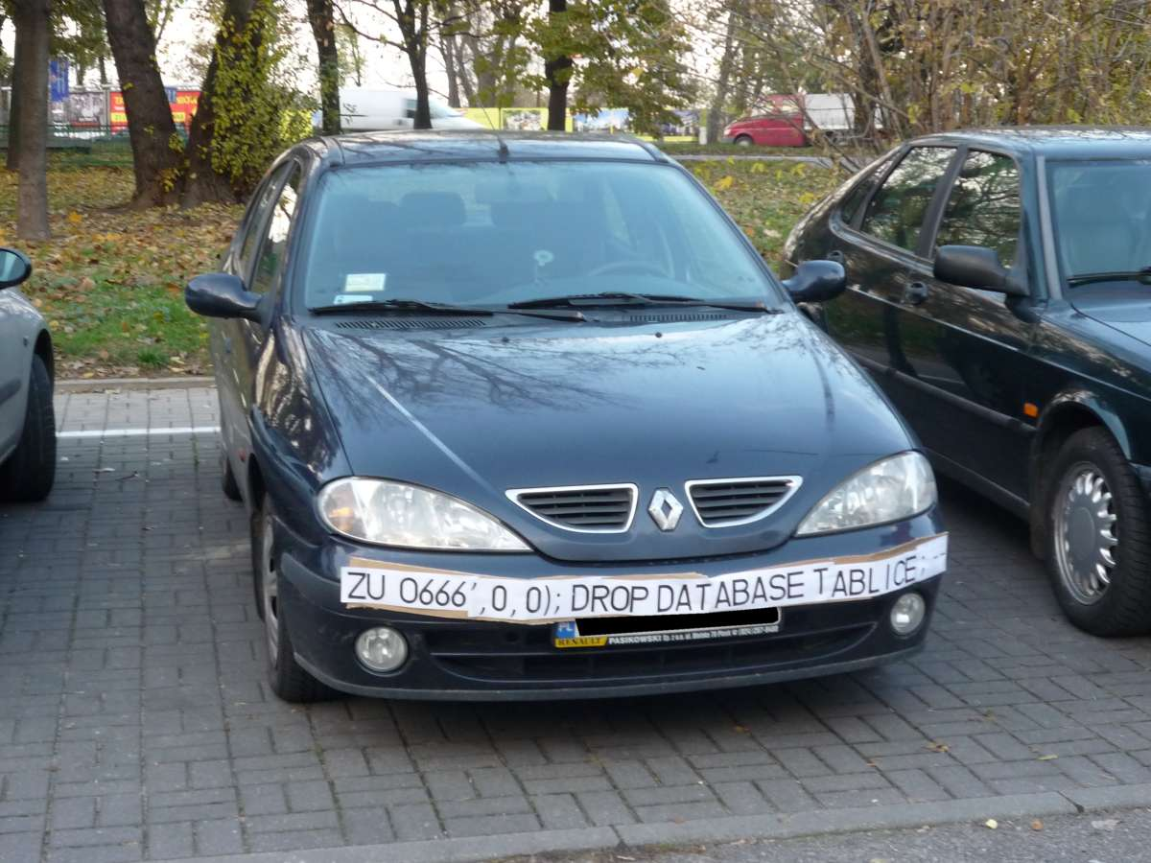



Slide 48
SQL Injection
SQL Server is better than all others… but is not immune to SQL Injection attacks made possible by security-ignorant development.
The Basics:
Parameterize the input from the website (use sprocs!)
Don’t run website SQL logins with more DB permissions than absolutely necessary (again, use sprocs!)
Notes:
<read notes instead>
This is a much larger topic with lots of info out there, I won’t do it justice today, but I will talk about what we as data professionals can do to combat it.
SQL Server is better than some RDBMS platforms but is not immune to SQL Injection attacks made possible by security-ignorant development.
Developers are the ones responsible for preventing or allowing vulnerabilities, and so they must be aware of SQL Injection-blocking patterns on public websites, such as …
Parameterize the input from the website (use sprocs!)
Don’t run websites logins with more databases permission than needed (again, use sprocs!)
And we’ll talk later about why stored procedures are so important and useful in dealing with security.

Slide 49
What can we do to prevent SQL Injection? 1
Refuse to give sysadmin or db_owner permissions. Demand more specific permissions from vendors, devs.
Design tables with appropriate data types and lengths.
Insist on stored procedures for public-facing operations. Be aware of what db’s have public apps.
Insist on stored procedures for Entity Framework (or other ORMs) operations involving 2+ entities
Notes:
<read notes instead>
But what can we as data professionals do to prevent SQL Injection, even when we don’t develop or own the applications writing to our database?
<read slide>

Slide 50
What can we do to prevent SQL Injection? 2
Avoid apps running with permissions like the db_datareader and db_datawriter roles, and certainly not db_owner.
Avoid the use of EXECUTE AS in code, which could allow injected code to execute with elevated security.
Train devs on patterns of stored procedure parameter sanitizing. Never use EXEC() or sp_executesql with user-enterable data.

Slide 51
What can we do to prevent SQL Injection? 3
Provide links, attention, and visibility to PM’s and Dev’s for SQL Injection awareness.
Lobby for penetration testing and SQL Injection detection tasks in sprints.
With Azure SQL DB, enable Azure Threat Detection!
Notes:
Finally, let’s talk about some more strategic things you can do.
<read slide>
Azure Threat Detection is a security intelligence feature built into the Azure SQL Database, activated with a button click. It uses machine learning to alert you to suspicious activity, like irregular usage times or IP addresses, suspected brute force or injection attacks, and more.

Slide 52
SSMS Vulnerability Assessment Tool
Built into SSMS, there is a Vulnerability Assessment tool available via Object Explorer in each Database -> Tasks.
Introduced in SSMS 17.4 in SQL 2017.
Findings include PUBLIC, GUEST, user-defined roles, low-impact roles, orphaned roles, least privilege, and more.
Notes:
<read notes instead>
What other easy steps can you take to secure your database?
SSMS has a built-in Vulnerability Assessment tool now, introduced a few years ago, and many of its findings are good common sense database-level permissions issues that we’re discussing today, like PUBLIC, GUEST, user-defined roles, low-impact roles, orphaned roles, least privilege, and more.
Ok, we’ve talked about permissions, we’ve talked about some operational or strategic security topics, let’s talk about database permissions and how some important database object types can help make your databases and applications more secure. Let’s start with stored procedures.

Slide 53
Database Object Security
Database Object Security
Notes:
Now I’m going to talk a little bit about database object permissions inside the database. I’ll assume you know the basics of GRANTing permissions, some of the basic read and write access permissions inside SQL Server as well. If you don’t, that’s ok, they’re obviously named. I’ll also assume you’re familiar with the table, the basic storage object of any relational database, where rows are queryable by end users. It’s the relationship between that data in the table, and the user’s end queries that I want to explore with a simple exercise.

Slide 54
Stored Procedures
Stored procedures require EXECUTE to run, and do not require underlying permissions (SELECT, INSERT, DELETE)
… assuming you don’t break one of these three rules:
1. the sproc doesn’t perform IDENTITY_INSERT on a table, which requires ALTER permissions.
2. all the underlying objects have the same ownership chain.
3. the sproc does not use dynamic sql commands like: exec sp_executesql @SQL or EXEC(@SQL)
Notes:
<read notes first>
Stored procedures are kindof a big deal, and we take them for granted. A big Synapse competitor, Snowflake for example, just straight up doesn’t have stored procedures.
<read slide, all three rules>
That last one is the big one, it’s the basic commands for executing strings of TSQL as dynamic SQL, this is a pretty big security no no and one common reason for why SQL injection attacks are successful. Stored procedures help insulate applications against SQL injection attacks. Even if you’re not a developer, everyone needs to be aware of what SQL injection attacks are because most public data entry forms and websites are under constant, automated SQL injection attacks.

Slide 55
Stored Procedures Security
Given those conditions, thanks to the database permission chain, you can:
GRANT EXEC rights to sprocs
GRANT no other permissions to the table!
Users can read/write data using sprocs ONLY.
Notes:
That way, no unauthorized SQL statements can be injected into the database via vulnerabilities in data entry forms.

Slide 56
User-Defined Functions
Similarly, a UDF will allow a user to SELECT data
Keep in mind the performance impact of functions can be severe. High potential for cursor-like effects.
New features in 2017 and 2019 addressed UDF performance
Notes:
Some of the performance issues with UDF’s were addressed in the last two releases of SQL Server.
In SQL 2017 the performance feature Interleaved Execution helped with performance of Table Value Functions.
In SQL 2019 the new scalar function in-lining feature helped reduce the negative performance impact of abused scalar User Defined Functions.

Slide 57
Views
Similar to sprocs
SELECT permission to query a VIEW will allow a user to SELECT data from table(s) without access to the tables.
GRANT SELECT ON [view] … is all you’d need.
Notes:
<read slide first, then notes>
(This is helpful!)
GRANT SELECT ON VIEW is all you’d need, instead of granting access to the underlying tables. In this way you can provide a horizontal or vertically partitioned view of data, excluding certain secure columns for example, or rows. This is a way to essentially perform row-level security. However, it’s not the only way.

Slide 58
Row Level Security
SQL 2016+ feature based on inline table-valued functions and a security policy.
Allows to you apply security policy to specific users, filtering specific tables.
Can block reads and writes against tables, without the use of triggers.
Notes:
<read notes>
This is a feature across all platforms, Azure SQL Database, Managed Instance, Azure Synapse Analytics, as well as SQL Server since SQL 2016.
<read slide>
This is useful, especially for reporting, but also for environments where databases have a variety of applications developed against them. You may have legacy databases with a mixed security environment of legacy and modern applications, perhaps low-code applications and mobile applications as well, and you want to help developers enforce a single, consistent row-level security policy at the database level.
https://docs.microsoft.com/sql/relational-databases/security/row-level-security

Slide 59
Demonstrate how Stored Procedures, Views, and Functions abstract the permissions necessary to SELECT underlying table data. Security p1.sql – logged in as sysadmin Security p2.sql – logged in as testing user
Notes:
This is a fun party trick to impress your friends and relatives and especially developers with your database security expertise.

Slide 60
Section Title 3
Special and Service Accounts

Slide 61
What is “DBO”?
In SQL 2000, sales.dbo.customers meant:
databasename = sales
owner = dbo
tablename = customers
In 2005 and later, sales.dbo.customers meant:
databasename = sales
schema = dbo
tablename = customers

Slide 62
What is a “schema”?
Schemas are securables that contain database objects.
By default, objects are inside the “dbo” schema.
Additional user schemas can (should) be created. Permissions can be granted to schemas as a set.
Examples:
logical [Staging], [ODS], [Audit], [WH]
business [Sales], [HR], [Acct], [Reporting]
Notes:
A schema is just a securable container, no longer implies “ownership”.
<read slide>

Slide 63
What is “DBO”?
In SQL 2000, dbo was a special user inside each database with sysadmin permissions, which by default owned any object created by an admin.
In SQL 2005 and above, dbo is still a special user that sysadmin logins are mapped to in each database.
Saying a user has “dbo permissions” is incorrect. Instead, “[sysadmin] or [db_owner] role membership.”
Notes:
<read notes>
Ok, but we really didn’t answer what dbo is.
<read slide>
So since 2005, the special dbo user and the full permissions implied by membership in the [db_owner] role are completely different. Also, let’s talk about “ownership”, because if you’re an old DBA like me, that’s also been redefined.

Slide 64
What is “ownership”?
Microsoft has mostly done away with the terminology of Users or Logins “owning” objects.
Changing the AUTHORIZATION is now the more accurate term to describe “ownership” of an object.
For example, sp_changedbowner is deprecated, replaced by ALTER AUTHORIZATION.
Databases should be “owned” by service accounts, not interactive accounts.
Notes:
<read slide first>
That syntax is for changing the quote owner unquote of a database, which hasn’t been updated in the Management Studio UI, but in the syntax, has been renamed to authorization.
Databases should be owned by service accounts, not interactive accounts.
So, what are service accounts? What’s an interactive account?

Slide 65
Interactive vs Service Accounts
Interactive Accounts = used by a human, typed in
Individual day to day accounts, admin accounts
Common shared team accounts (never recommended)
Still best to grant to interactive accounts via AD Groups
Service Accounts = never typed in by a human
Regular AD Accounts where the password is long and more importantly, not known to anyone outside of a password vault

Slide 66
Interactive vs Service Accounts
Appropriate use:
Database owner | Service Account
SQL Agent job owner | Service Account
Schema owner | Service Account
Availability groups owner | Service Account
SQL services service account | Service Account
Application connection strings | Service Account
Notes:
Again, note here that none of these system objects or accounts are appropriate to be owned by an interactive account, that is, your account. If your interactive account expires while you’re in vacation, is locked out maliciously or accidentally, or is disabled when you leave, stuff will probably stop working in fun and exciting ways. You should regularly check to make sure, for example, that you have not become the owners of any databases or jobs you create, including jobs created by Management Studio Maintenance Plans, which have a habit of creating SQL Agent Jobs with your name on them.
Now, one question you probably have, is if the built-in sa account, the SQL Authenticated login that you probably set a password for at install. Does the ‘sa’ account count as an interactive account or a service account? The answer is, it depends on how you use it. I’m OK with databases or jobs being owned by ‘sa’, as long as nobody is using the ‘sa’ account. And ideally, nobody uses the ‘sa’ account. Again, all administrators, even contractors or managed service providers, should be accessing the SQL Server via their personal Active Directory admin accounts. If the ‘sa’ password is painful to enter and not passed around, and only stored in a password vault somewhere, I’m ok with calling ‘sa’ a service account. But if you have old school administrators who like to log in as ‘sa’, then no, we need to fix that behavior, because it’s problematic for reasons we’ve already discussed.
Now, as for service account, I said nobody knows the password. Well, doesn’t somebody need to know the password? Actually, no! Let’s talk about MSAs, gMSAs, and VSAs.

Slide 67
VSA vs MSA (and gMSA)
Virtual Service Account – managed by machine
Examples: [NT SERVICE\MSSQLSERVER], [NT SERVICE\SQLSERVERAGENT]
Managed Service Account – managed by DC
Examples: [Spark\msa_SQLSERVER1$]
PowerShell to install:
Install-ADServiceAccount -Identity "msa_whatever"
Group Managed Service Account - gMSA
Notes:
VSA’s are specific to a machine, and for standalone SQL Server instances, they’re perfectly fine and secure to use as the SQL Server or SQL Agent service accounts, for example. They’re installed that way by default unless you specify another service account, and they’re managed by the operating system to simplify the service security. It’s automatically managed, and can even be given access to resources out of the network. Whenever you do that, via a Windows File Share for example, you append a dollar sign to the end of the account, because this is a local computer account.
<click>
However, if you’re configuring an old fashioned Failover Cluster Instance or an availability group, it’s best to configure the SQL Server service account to be a service account managed by the Domain Controller. This can be a standard account you create in AD with a strong password that nobody knows, or, you can use a Managed Service Account. In fact, Microsoft recommends using a Managed Service Account with minimal privileges for any time a SQL Server needs to reach outside its own operating system. Here’s the great thing about MSA’s, they can’t be used interactively. And when you go to provide an MSA to SQL Server Configuration Manager, you just leave the password blank. And MSA’s can only be used on Servers they’ve been configured for, often with PowerShell. For example,
<click>
Once the MSA has been created in Active Directory, this PowerShell here is all that is needed before using an MSA as the Service Account for SQL Server.
<click>
Now, if you want to configure the same Managed Service Account for multiple instances, like in a failover cluster or availability group for example, you can use a Group Managed Service Account, which can be installed and used on multiple servers. Active Directory will automatically and regularly update the gMSA password on each server, quietly and behind the scenes, without any interruptions or outage or restart.
Note that a lot of what I’m talking about is relatively new, in the last few years, on this page may not be available on older operating systems or SQL Server versions. For example, support for gMSA’s was introduced in SQL 2014 and Server 2012 R2, and SQL 2016 is needed for some other scenarios with gMSAs.

Slide 68
Wrapup Section
Wrapup and Questions

Slide 69
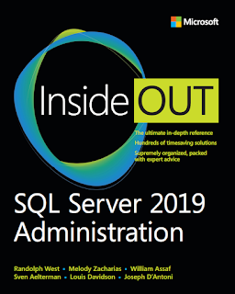
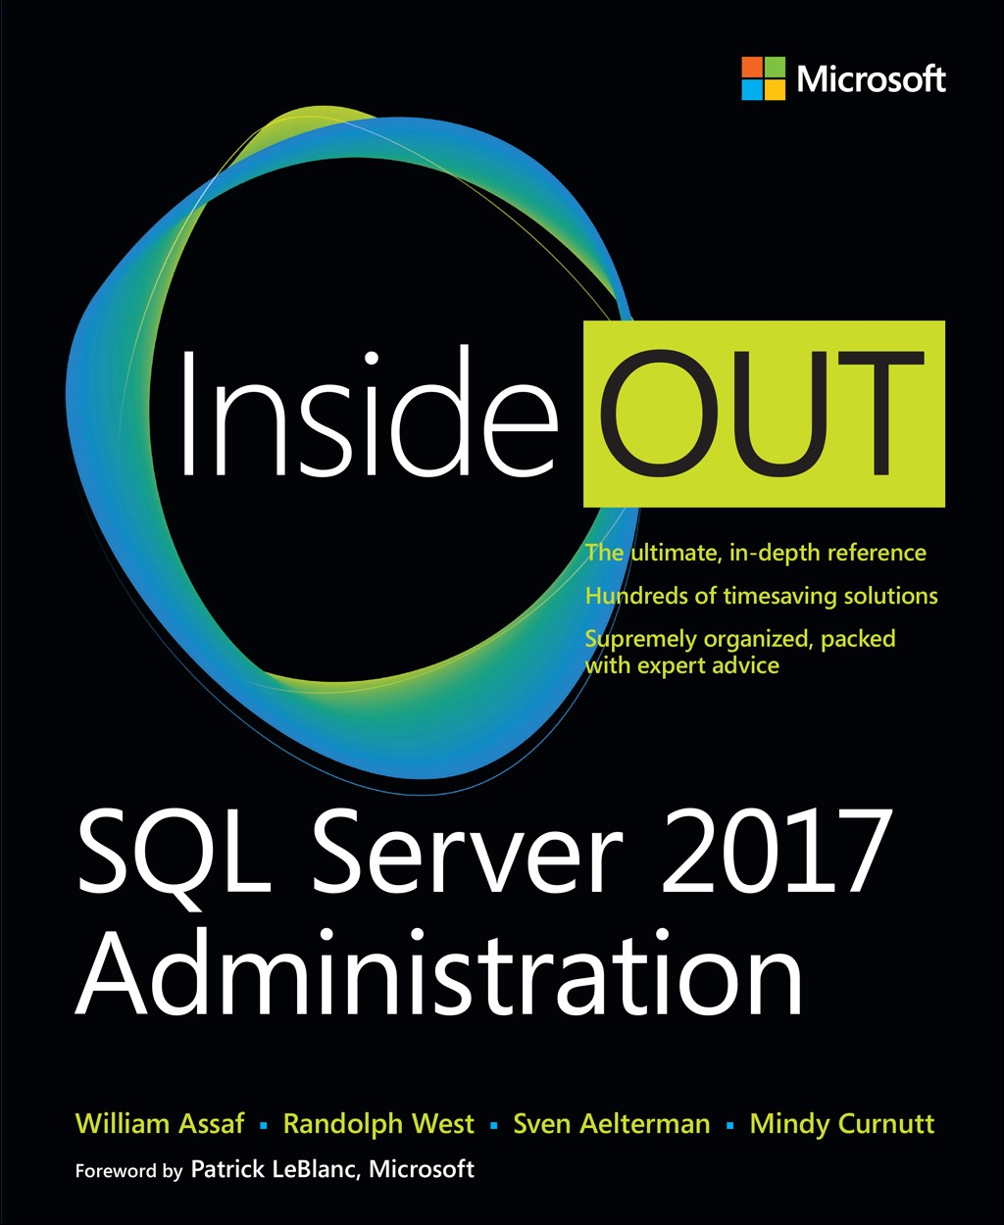
SQL Server 2017 Inside Out
SQL Server 2019 Administration Inside Out
by Microsoft Press
2017 published Feb 2018
2019 published March 2020

Slide 70

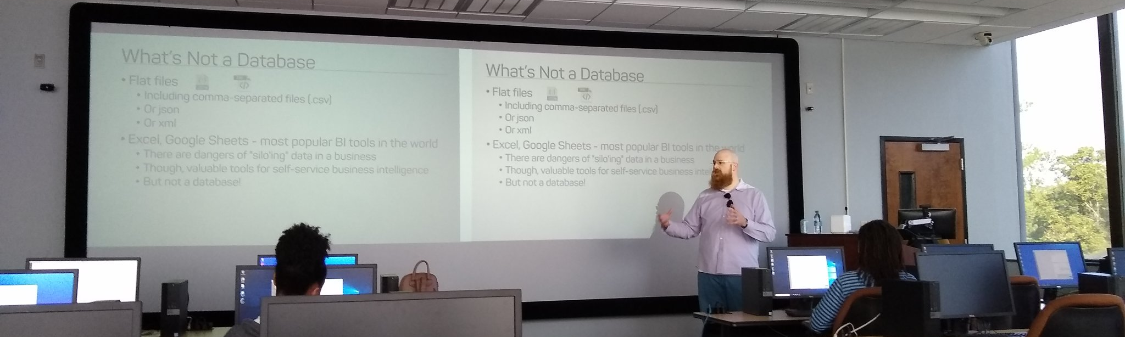
Support your Local STEM Initiatives
I encourage you to find, then donate time and money to local STEM education initiatives where you live. Get involved!
There is almost certainly some nonprofit where you live that needs your enthusiasm and skills to close the achievement gap.
https://www.thewallsproject.org/programs/futures_fund/
Notes:
Here’s a STEM education nonprofit local to me that I volunteer for, please reach out and share your knowledge with the next generation, and especially with folks in your community that are needing to find new careers during the pandemic.

Slide 71


William Assaf
Former Principal Consultant, Former Microsoft MVP Data Platform
Former PASS Regional Mentor, Former SQLSaturday and UG Co-Organizer in Baton Rouge, La., USA.
he/him
Senior Content Developer, SQL-Docs, Microsoft
SQLTact.com
Co-author, Microsoft Press SQL Server Administration Inside Out 2017 and 2019. Former MS Cert writer.
linkedin.com/in/williamdassaf
@william_a_dba
Notes:
This presentation is available for download at my blog SQLTact.com.

